Slide 1

With all this data, can we make any money with Machine Learning?
Deep Learning and Monte Carlo
Cluster Analysis

Slide 2
With all this data, can we make any money with Machine Learning?
S&P 500 Stocks with five years of data
Started with six factors
Valuation – Price/Earnings, Price/Book, Enterprise Value/Revenue, Enterprise Value/EBIT
Quality – Net Debt / Capital
Size – Market Capitalization
Added three more
Momentum – Trailing 1 month, 3 month and 12 month returns

Slide 3
Deep Learning & Monte Carlo
Can we train the model to put stocks into one of three groups
Outperformers, Market Performers and Underperformers
Use the prior two years’ worth of data
Split the data into train/test by ticker, with a different split each month
Run the Deep Learning model with two layers, 100 nodes and 40 epochs
Since stock returns within a given month are correlated, if we tested the model within the same timeframe as the training, there would some “look-ahead” bias. To prevent that, we tested using the total returns on the month after the training.

Slide 4
Deep Learning & Monte Carlo
Did the Monte Carlo simulation by running the Deep Learning model 30 times, then averaging the results
One complete Monte Carlo test had 540 Deep Learning runs, took 8 hours to complete
The average model loss was 1.23
The average model accuracy was 0.366.

Slide 5
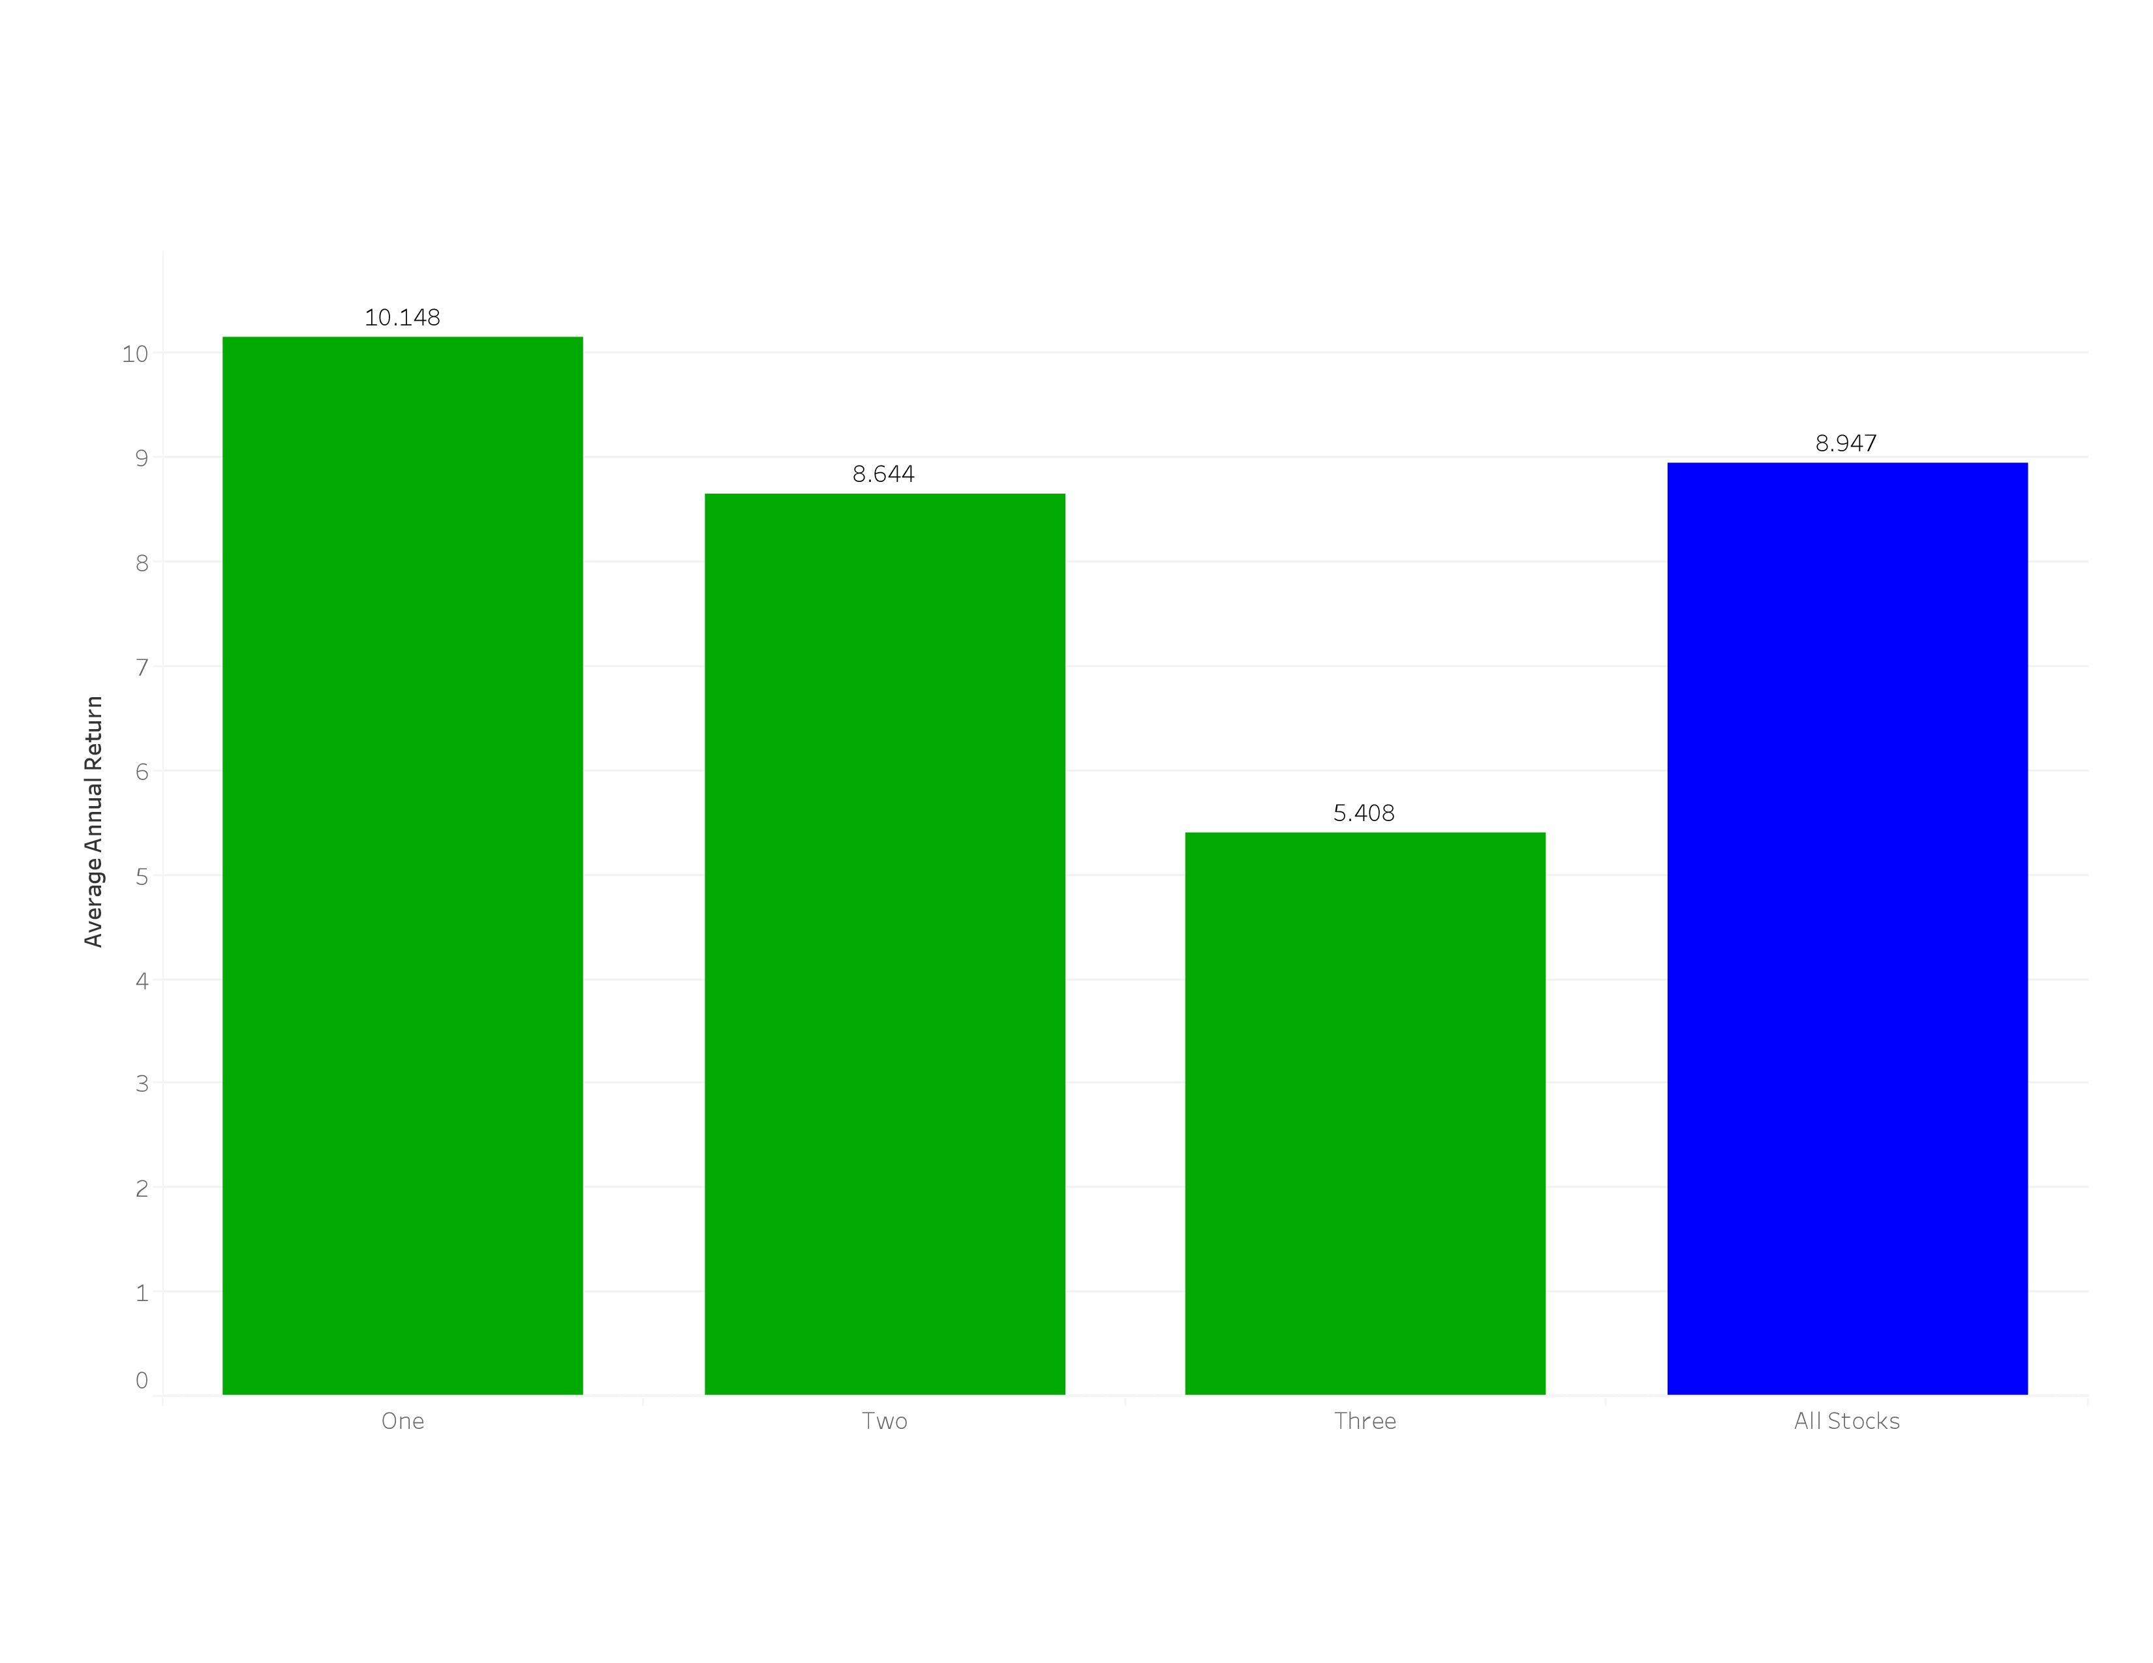
Average Annual Return by Tertile

Slide 6
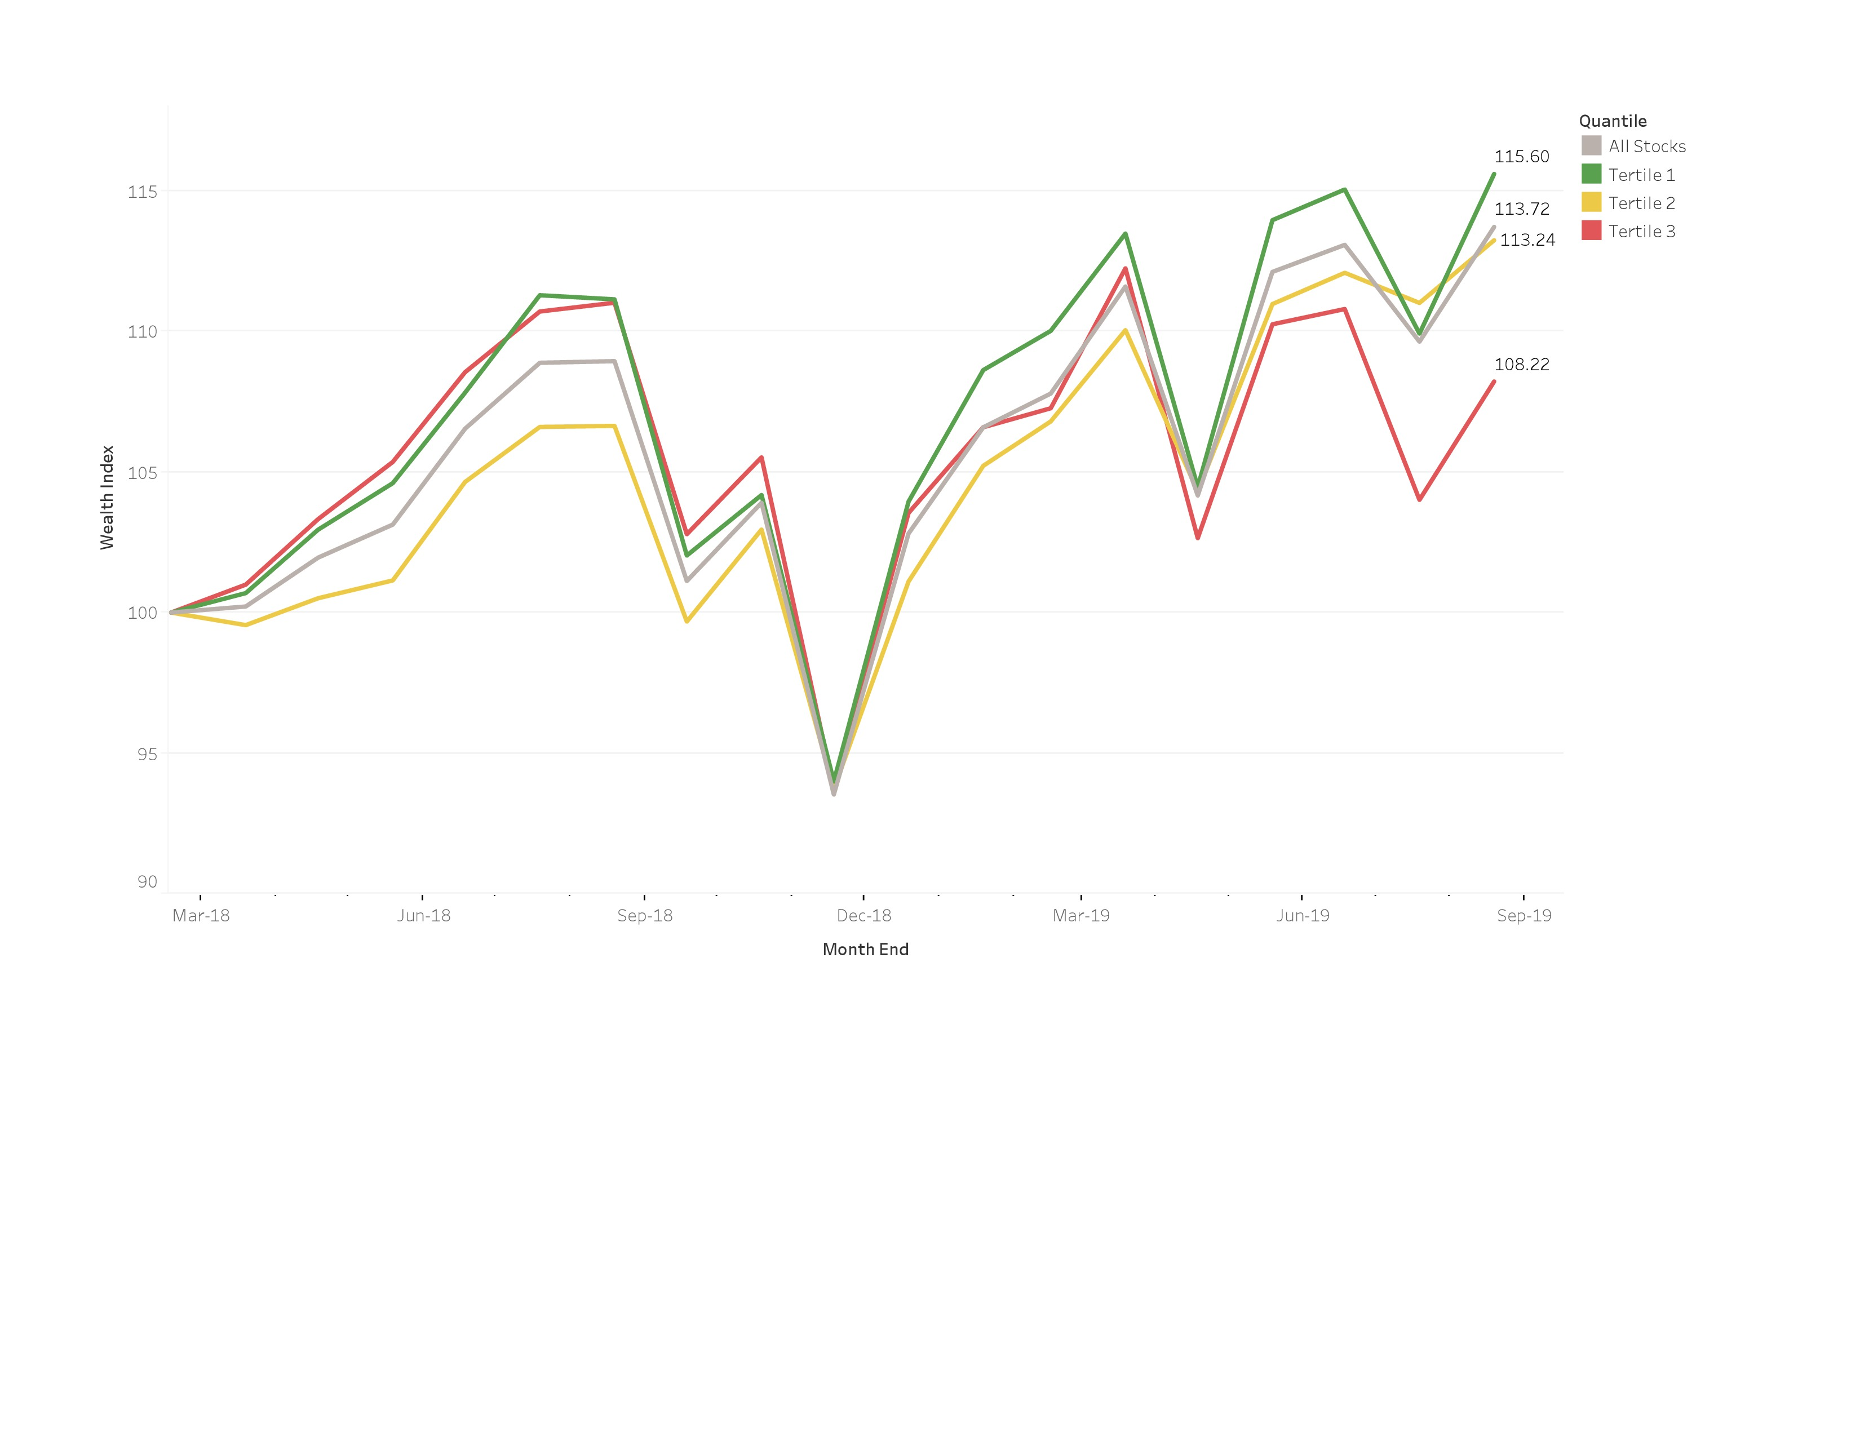
Wealth Indices by Tertile

Slide 7
Are the differences in monthly returns statistically significant?
Between | and |  | t-statistic | p-value
One | Two |  | 2.01 | .04501
One | Three |  | 3.66 | .00027
Two | Three |  | 2.06 | .04002

Slide 8
Why only 18 months of results?
Started with 20 quarters of financial data and 60 months of price data
– 2 months to lag financial data
– 2 months for fiscal year differences
– 12 months to calculate the momentum factor
– 24 months for deep learning
– 1 month for train/test difference
– 1 month as we can’t test the final set of data
= 18 months of results

Slide 9
Conclusions
The model worked over this 18-month period
Statistically significant difference in monthly returns, but 18 months of data is not a lot
Works well in bull markets (most of this time period)
Not so sure about bear markets (had one in 4Q 2018)

Slide 10
Comments
Would have liked more data, but this was what we could get for free.
All financial data was lagged by two months
All calculations on valuation formulas were done with “price” or “enterprise value” in the denominator, i.e. on “earnings yield” instead of “price/earnings”.
All return data is “Total Return” with dividends reinvested in the issuer’s stock.

Slide 11
Caveats
Survivor Bias – This study does not include companies that were either taken over or failed during the time frame. Thus, it does not represent what would have happened in real-time. We did not have access to the data on such companies.
Restated Data – Occasionally, companies will restate their financial results, sometime years after the fact. The financial data we received typically shows the restated data. Thus, investors might have had different financial data on certain companies back in time.
No transaction costs – Trading stocks incurs transaction costs and market impact. This back test does not include any reduction in returns due to those issues.

Slide 12
Cluster Analysis
With the factors available, can Cluster Analysis classify the stocks into their economic sectors?
If so, are there any unusual categorizations of some stocks that would lead to interesting insights?
Multi-dimensional KMeans analysis
Tested one to thirty clusters
Eight clusters was most efficient

Slide 13
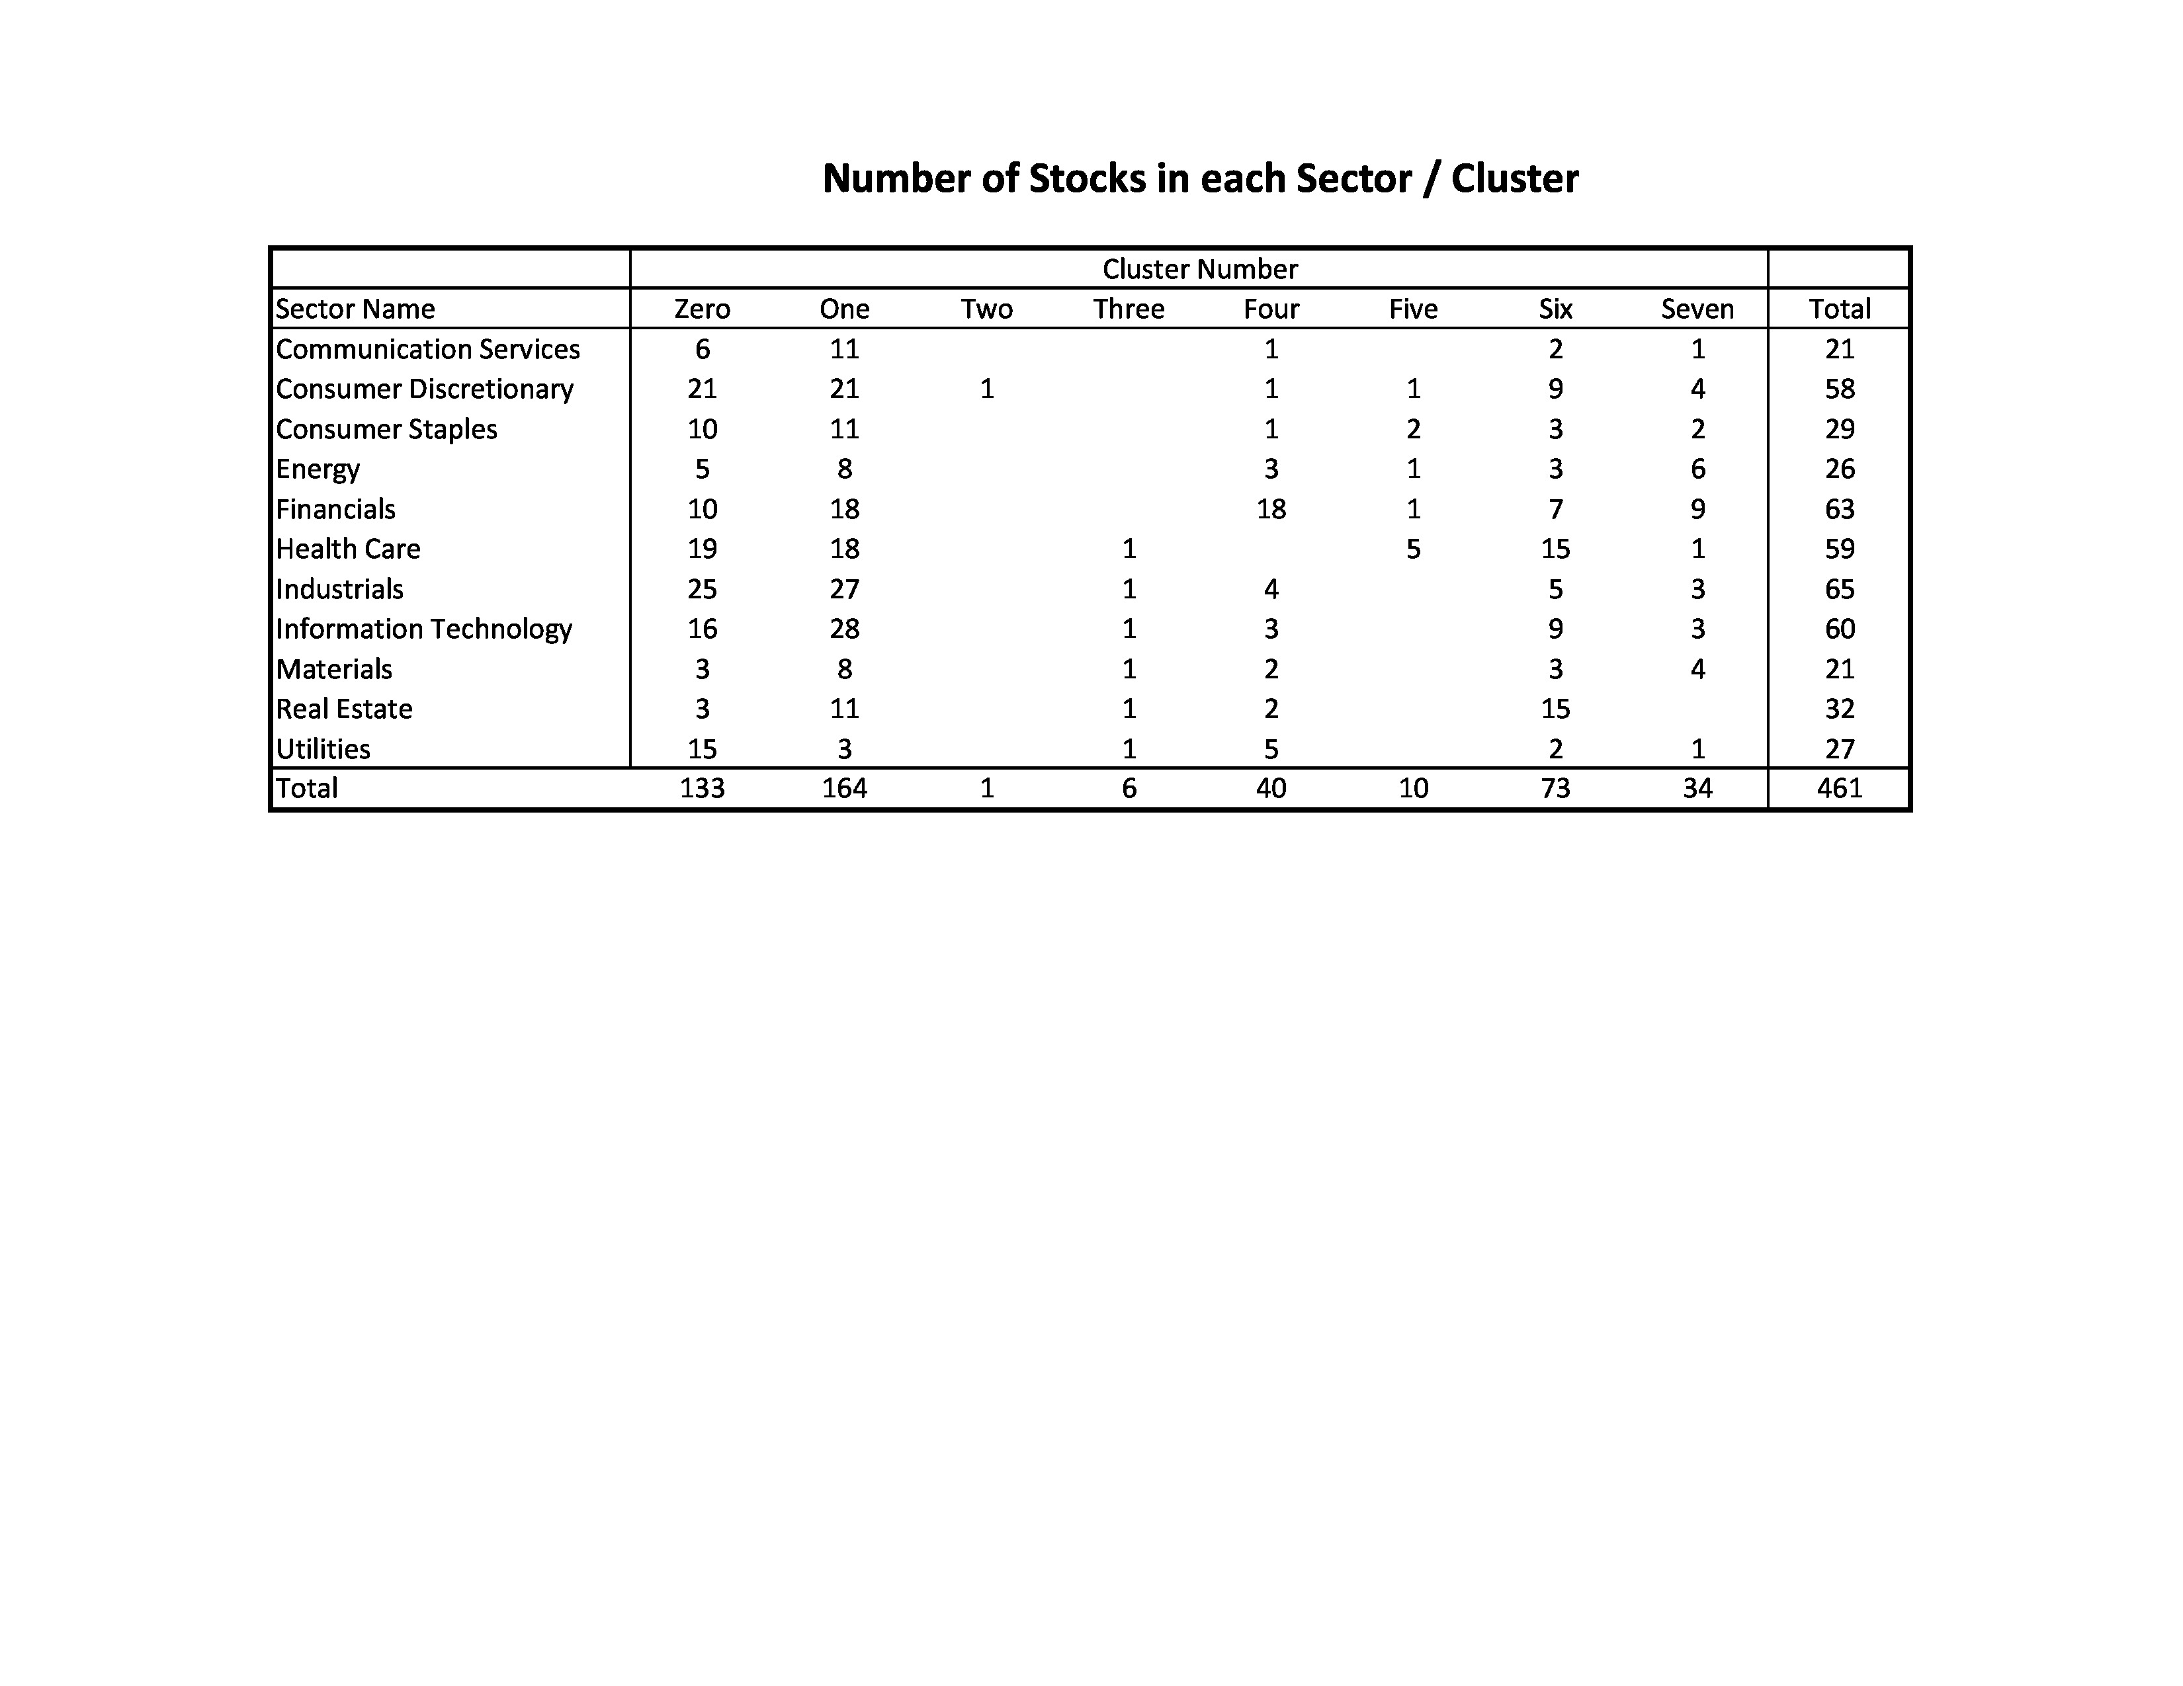
Cluster Analysis

Slide 14
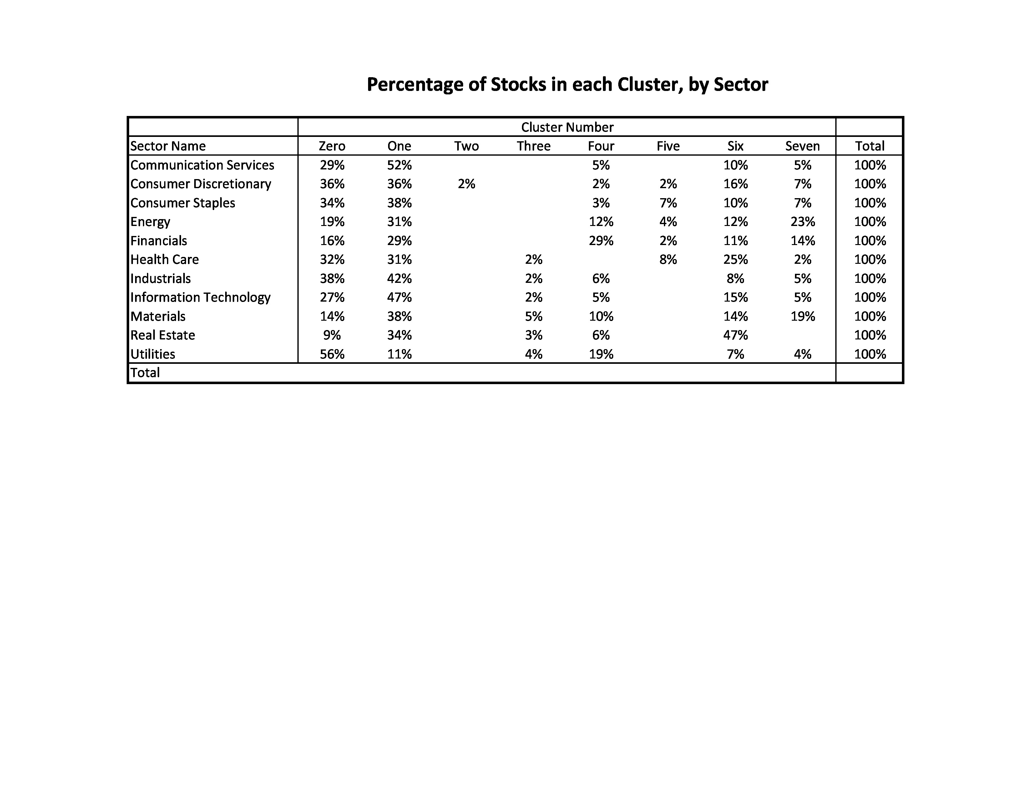
Cluster Analysis

Slide 15
Cluster Analysis
Despite the eight clusters being most efficient, there was one cluster that only had one stock
Re-ran the analysis with fewer clusters, but always had one cluster with one or two stocks
Conclusion – We need additional features to be able to use cluster analysis reliably

